Slide 1
Comments on "The Eurasian roundabout: Trade flows into Russia through the Caucasus & Central Asia

Slide 2
What does the paper do?
Documents how the share of CCA3 (Armenia, Kazakhstan and Kyrgyz Republic – all members of the Eurasian Economic Union) in the exports of the EU and the US has increased, while the share of Russia in the exports has collapsed as the sanctions have kicked in
Shows how the export increase to CCA3 is statistically significant in goods that have been sanctioned by the EU (also in similar goods)
Shows that exports of sanctioned (or similar) goods from China and Türkiey to Russia also increased
Very nice and concise paper on a very important topic

Slide 3
Some further notes on the data etc.
Offical customs data, does not cover smuggling
HS6 product group level data, so no product level data (sometimes sanctions have not been very clear on the exact HS codes etc.)
Does this make the paper less important? No. We are economists, and – while more detailed data would be nice – we can also reach some conclusions with less than perfect data. We can get a pretty good sense of direction and of the order of magnitude. We can always debate the details, obviously…
”…increased exports to CCA3 account for a small fraction of the drop in direct trade.”

Slide 4
Some comments on the regressions
Being able to distinguish between sanctions related to luxury goods, industrial/transport capacity and dual-use and military technologies is very valuable (although some more descriptive statistics e.g. on the value of their exports pre-invasion etc. Would be valuable)
In addition to CCA3, also Georgia is subjected to more detailed analysis – why this country and not some others (Mongolia and Azerbaidzan are mentioned) – although interaction terms with Georgia usually are not statistically significant (and exports of similar goods to Georgia declined)

Slide 5
”…increased exports to CCA3 account for a small fraction of the drop in direct trade.”
This is good to hear, but it would be nice to see some summary statistics on Russia’s total imports in certain product categories from the EU/US/UK and CCA3/China/Türkiye
If/when there are differences in product categories (even at the very aggregate level of luxury goods etc.) what do they tell us of the policy priorities of Putin’s administration?

Slide 6
Data ends December 2022 – so I find it easy to suggest more analysis ☺
Do the stipulations of the 10th sanctions package relating to transit trade via Russia have an effect?
Trying to stop sanctions avoidance whack-a-mole? If we see that exports from some countries to Russia decline, do other countries take their place?

Slide 7
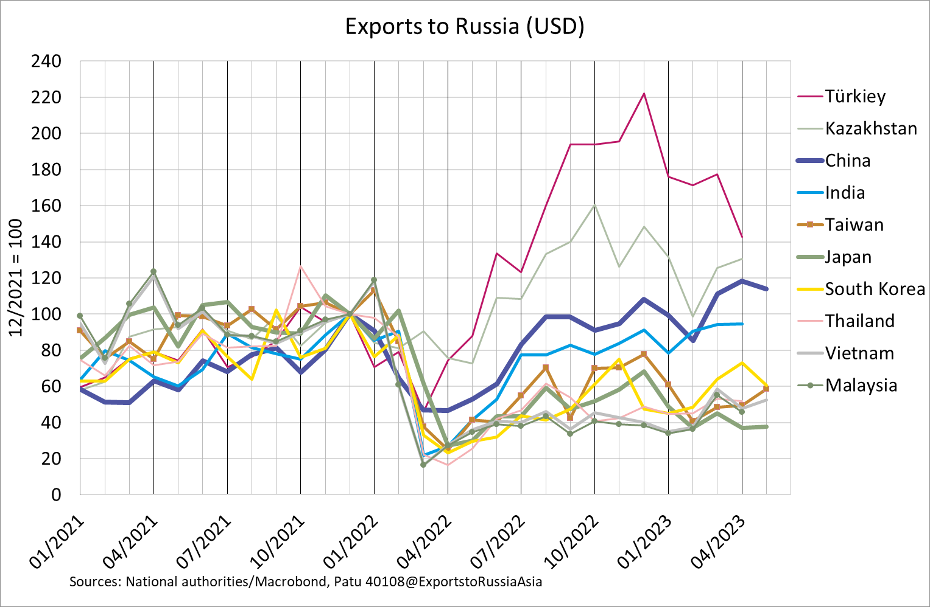
What has happened since December 2022?

Slide 8
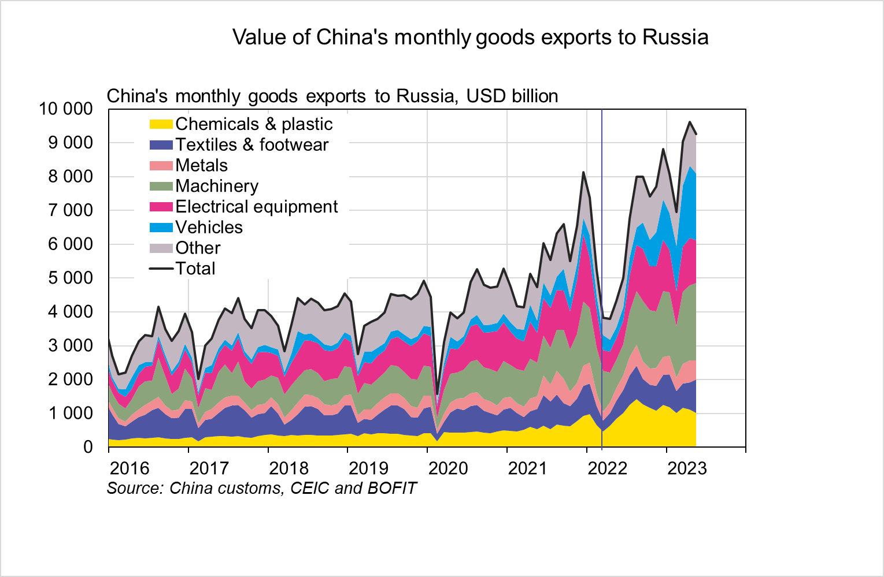
China’s exports to Russia – growth especially in vehicles

